Slide 1
File Management
CS 3100 – Chapters 10-11
SUPPLEMENTAL NOTES
For Week 10

Slide 2
File Concept (10.1)
Contiguous logical address space
Types:
  Data: numeric, character, binary
  Program: source, object (load image), executable
  Documents

Slide 3
File Attributes (10.1.1)
Name – only information kept in human-readable form.
Identifier – unique non human identifier
Type – needed for systems that support different types.
Location – pointer to file location on device.
Size – current file size.
Protection – controls who can do reading, writing, executing.
Time, date, and user identification – data for protection, security, and usage monitoring.
Information about files are kept in the directory structure, which is maintained on the disk.

Slide 4
File Operations (10.1.2)
Create
Read
Write
Reposition within file – file seek
Delete
Truncate
Open
Close

Slide 5
Information in Open File Table
File pointer – where in the file to read or write.
File open count – number of processes that are using this file.
Disk location of file – where the file is located on disk.
Access rights – allows or denies subsequent I/O requests.

Slide 6
Access Methods (10.2)
Sequential Access
  read next
  write next
  reset
  Skip forward/backward n records
Direct Access
  n = relative block number
  read n, write n
  position to n, read next, write next, rewrite n

Slide 7
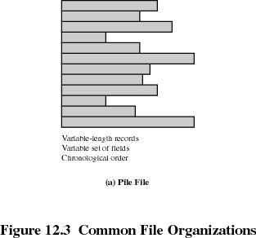
File Organization
The Pile
  Data are collected in the order they arrive
  Purpose is to accumulate a mass of data and save it
  Records may have different fields
  No structure
  Record access is by exhaustive search

Slide 8
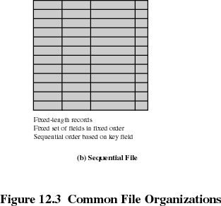
File Organization
The Sequential File
  Fixed format used for records
  Records are the same length
  All fields the same (order and length)
  Field names and lengths are attributes of the file
  One field is the key field
    Uniquely identifies the record
    Records are stored in key sequence

Slide 9
File Organization
The Sequential File (cont)
  New records are placed in a log file or transaction file
  Batch update is performed to merge the log file with the master file

Slide 10
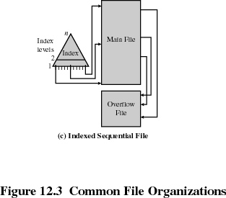
File Organization
Indexed Sequential File
  Index provides a lookup capability to quickly reach the vicinity of the desired record
    Contains key field & a pointer to the main file
    Index is searched to find highest key value that is equal or less than the desired key value
    Search continues in the main file at the location indicated by the pointer

Slide 11
File Organization
Indexed Sequential File
  New records are added to an overflow file
  Record in main file that precedes it is updated to contain a pointer to the new record
  The overflow is merged with the main file during a batch update
  Multiple indexes can be set up to increase efficiency

Slide 12
File Organization
Comparison of sequential and indexed sequential
  Example: a file contains 1 million records
  On average 500,000 accesses are required to find a record in a sequential file
  If an index is introduced containing 1000 entries (in 1000 increments), it will take on average 500 accesses to find the key in the index, followed by 500 accesses in the main file.
  Now, on average, it is 1000 accesses vs. 500,000.

Slide 13
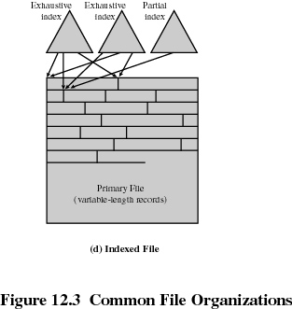
File Organization
Indexed File
  Uses multiple indexes for different key fields
  May contain an exhaustive index that contains one entry for every record in the main file
  May contain a partial index where the field of interest exists.

Slide 14
File Organization
The Direct, or Hashed, File
  Exploits the capability found on disks to access directly any block of a known address.
  Key field required for each record
  Used where very rapid access is required, where fixed length records are used, and where records are accessed one at a time. Examples are directories, pricing tables, schedules, and name lists.

Slide 15
Directory Structure (10.3.2)
A collection of nodes containing information about all files.
Both the directory structure and the files reside on disk.
Directory
Files
F 1
F 2
F 3
F 4
F n

Slide 16
File Directories
Contains information about files
  Attributes
  Location
  Ownership
Directory itself is a file owned by the operating system
Provides mapping between file names and the files themselves

Slide 17
Directory Organization Benefits
Efficiency – locating a file quickly.
Naming – convenient to users.
  Two users can have same name for different files.
  The same file can have several different names.
Grouping – logical grouping of files by properties, (e.g., all C# programs, all games, …)

Slide 18

Single (Simple) Structure for a Directory (10.3.3)
List of entries, one for each file
Sequential file with the name of the file serving as the key
Provides no help in organizing the files
Forces user to be careful not to use the same name for two different files

Slide 19

Two-Level Directory (10.3.4)
Separate directory for each user.
Can have same file name for different users
Efficient searching
No grouping capability -Shared Data Problem

Slide 20

Tree Structured Directories (10.3.5)

Slide 21
Tree Structured Directories (Cont)
Absolute or relative path name
Efficient searching
Grouping Capability
Current directory (working directory)
Creating a new file or subdirectory is done in current directory.

Slide 22
File Sharing
Sharing of files on multi-user systems is desirable
Sharing may be done through a protection scheme
On distributed systems, files may be shared across a network
Network File System (NFS) is a common distributed file-sharing method

Slide 23
File Sharing – Multiple Users
User IDs identify users, allowing permissions and protections to be per-user
Group IDs allow users to be in groups, permitting group access rights

Slide 24
Protection
File owner/creator should be able to control:
  what can be done
  by whom
Types of access
  Read
  Write
  Execute
  Append
  Delete
  List

Slide 25
Access Lists and Groups
Mode of access: read, write, execute
Three classes of users
RWX
a) owner access 7 ⇒ 1 1 1
RWX
b) group access 6 ⇒ 1 1 0
RWX
c) public access 1 ⇒ 0 0 1
Ask manager to create a group (unique name), say G, and add some users to the group.
For a particular file (say game) or subdirectory, define an appropriate access.
owner
group
public
chmod
761
game
Attach a group to a file
chgrp G game

Slide 26

Windows XP Access-control List Management

Slide 27
File Management Overview (11.1)
File management system is considered part of the operating system (a system service)
Input to applications is by means of a file
Output is saved in a file for long-term storage
File Management is a Layered Approach

Slide 28
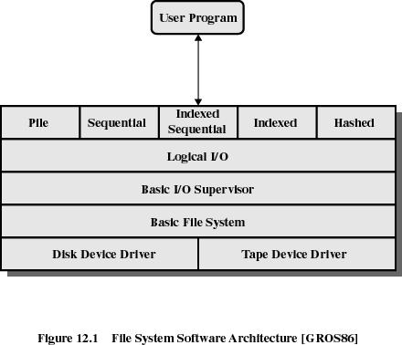

Slide 29
Access Method
Reflect different file structures
Different ways to store and process data

Slide 30
Logical I/O
Enables users and applications to access records
Provides general-purpose record I/O capability
Maintains basic data about file

Slide 31
Basic I/O Supervisor
Responsible for file I/O initiation and termination
Control structures are maintained by OS
Concerned with scheduling access to optimize performance

Slide 32
Basic File System
Physical I/O
Deals with exchanging blocks of data
Concerned with the placement of blocks on disk
Concerned with buffering blocks in main memory

Slide 33
Device Drivers
Lowest level
Communicates directly with peripheral devices
Responsible for starting I/O operations on a device
Processes the completion of an I/O request

Slide 34
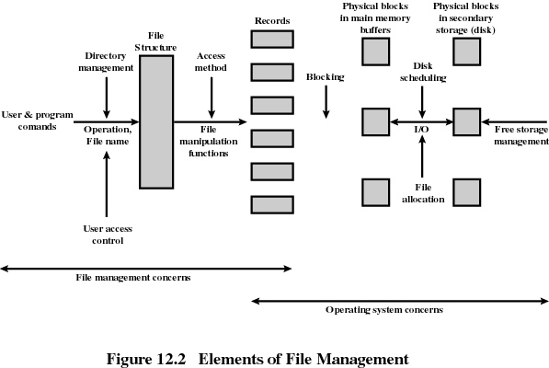

Slide 35
File System Mounting (11.2.2)
A file system must be mounted before it is available to use.
  The OS is given the name of the device and the location within the file structure at which to attach the file system.
  The OS verifies that the device contains a valid file system (Raw vs. Cooked).
  The OS notes in its directory structure that a file system is mounted at the specified mount point.

Slide 36
File System Mounting (Cont)
Boot Partition is Separate
Root Partition contains the OS Kernel and other system files
Windows Mounts (Partitions) into a separate namespace (d:\, e:\, etc)
Unix file systems can be mounted at any directory.

Slide 37
Directory Implementation (11.3)
Linear list of file names with pointer to the data blocks.
  Simple to program.
  Time-consuming to execute.
Hash Table – linear list with hash data structure.
  Decreases directory search time.
  Collisions – situations where two file names hash to the same location.
  Fixed size of hash table is a problem.

Slide 38
Allocation Methods (11.4)
Three major methods of allocating disk space are in wide use:
  Contiguous
  Linked
  Indexed

Slide 39
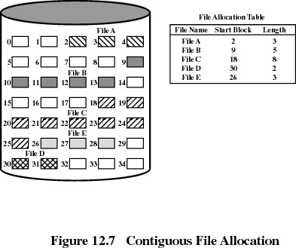
Methods of File Allocation (11.4.1)
Contiguous allocation
  Single set of blocks is allocated to a file at the time of creation
  Only a single entry in the file allocation table
    Starting block and length of the file
Little Head Movement
External fragmentation will occur
What Size to reserve for file? Using Extents can help.

Slide 40
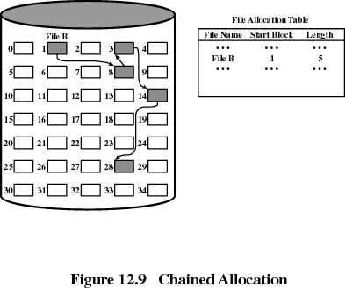
Methods of File Allocation (11.4.2)
Linked allocation
  Allocation on basis of individual block
  Each block contains a pointer to the next block in the chain
  Only single entry in the file allocation table
    Starting block and length of file
No external fragmentation
Best for sequential files
FAT Table helps with Random Access, but requires many disk “seeks” back and forth.
Each Block has pointer information storage at the beginning (takes away from the available block storage).

Slide 41
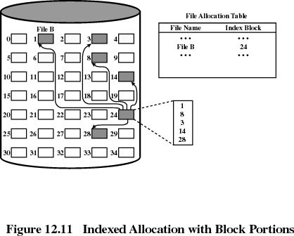
Methods of File Allocation (11.4.3)
Indexed allocation
  File allocation table contains a separate one-level index for each file
  The index has one entry for each portion allocated to the file
  The file allocation table contains block number for the index
  Dynamic access without external fragmentation, but have overhead of index block – remember the index block is same size (512 bytes) as regular blocks.

